Slide 1
Vestibular Apparatus
Dr. DEEPA G.S
Assistant Professor
Dept. of Physiology and Biochemistry

Slide 2
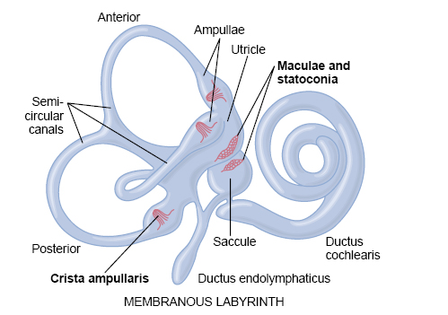

Slide 3
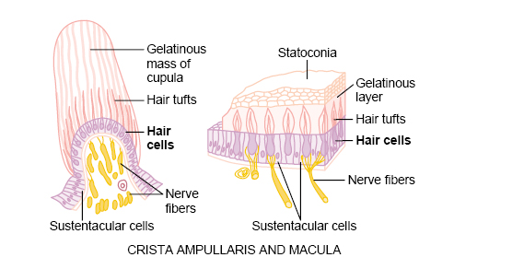

Slide 4
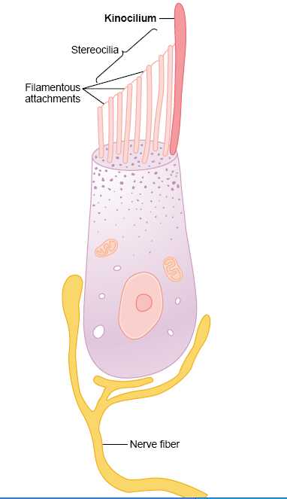
Hair cell of the equilibrium apparatus and its synapses with the
vestibular nerve.

Slide 5
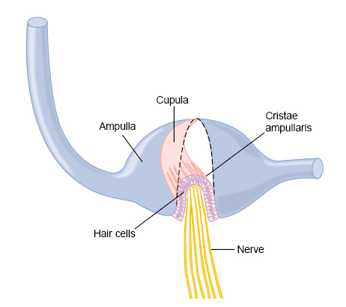
Movement of the cupula and its embedded hairs at the onset of
rotation.

